Slide 1
Find Your Space
Jacqueline Canning, Peyton Johnston, Zach Lieberman, Avery Goldberg, Peter Hemphill

Slide 2
Value Proposition
Have you ever had to walk around a library or your dorm during peak hours unable to find a space to study? FindYourSpace is an innovative new system to find your study space in seconds and not minutes. Our map-based software allows University of Virginia students to log in and see available study spaces in seconds.
Study time should be spent studying, not finding a free space.

Slide 3
Customer Discovery
Daily Goals: To complete their homework in a timely fashion
Pains: Waking up on time for classes and how long it takes to either walk to class or wait for the buses
Product: People enjoyed the idea, but it didn’t immediately come to their minds. One person gave us the idea for the hold feature.
Surprised: People often said they truly want to learn and succeed in classes.

Slide 4
Market Research
Similar applications with different goals
No patents about which to be concerned
Similar applications include
SFpark
University Library Websites (such as UC Berkeley)

Slide 5
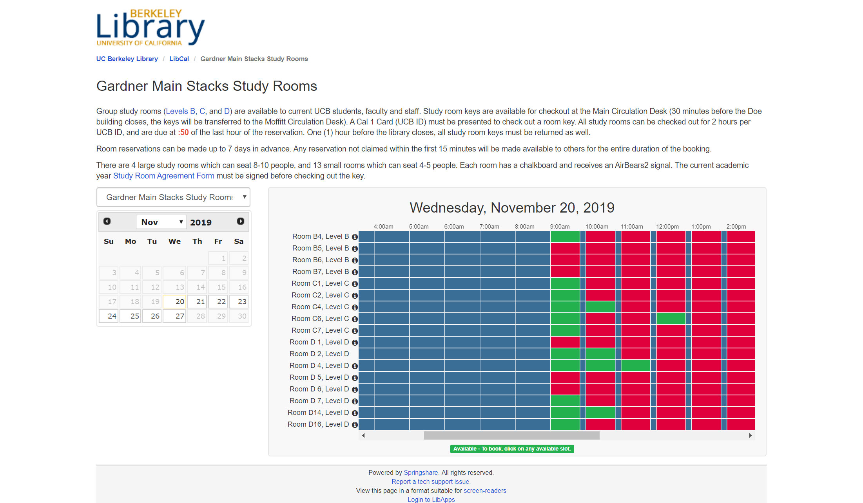

Market Research
Examples
SFpark

Slide 6
Prototype 1

Slide 7
Prototype 2

Slide 8
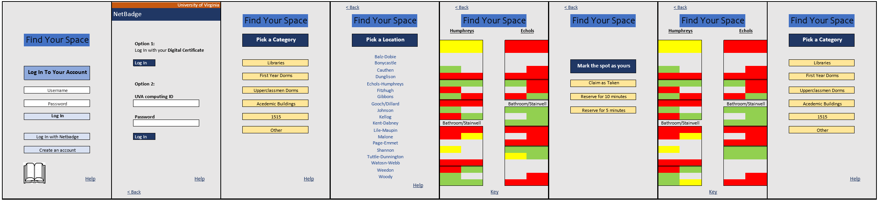

Slide 16
Business Thesis
UVA students will use Find Your Space to see the availability of open study spaces in real time, to find a study spot faster because study time should be spent studying, not finding a free space.
**Productivity while studying is projected to increase by 80%

Slide 17


Time/Money Estimates
$130/hour for experienced app developer
Apps with web servers between $8,000 and $50,000 to make generally, the more features the more expensive (longer it takes). Ours has fewer features. (61 to 390 hours)
Maintenance: 15-20% of development ($1,600 to $10,000)

Slide 18

Making Money
University Subscription:
$0.50/ student (round to nearest hundred) roughly $12,000 for UVA
Ad Banners in App: *Based on 2018-2019 data:
16,777 undergraduate students (*assume 60% use 2 min/day)
7,862 graduate students (*assume 40% use 2 min/day)
13, 144 users per day, 4 ads for 2 min. Makes around $78.87/day
34 academic weeks during the year. That is $2,681.24.

Slide 19
Conclusion
FindYourSpace provides University of Virginia students with a quick and easy way to check and reserve study spaces all over grounds.
Comments or questions?

